Slide 1

Recommendation System Using Machine Learning
Presented By
Mr. Aranav Mahalpure
TE (Computer Engineering)
Roll No. : TCA66
Under the guidance of
Prof. Abhijeet Sagare
Department of Computer Engineering
Hope Foundations
International Institute of Information Technology, Hinjawadi, Pune-411057
A.Y. 2023-24

Slide 2
Contents​
Introduction
Motivation
Literature Survey
Summary/findings of Literature Survey
Objectives
Conclusion
References
Technology Stack
Implementation

Slide 3
Introduction
Have you ever Wondered how Youtube recommends content
How Facebook recommends you, New Friends?
Perhabs you’ve noticed similar Recommendation with the Linkedin connection
How Amazon Recommends the Product while You’re Browsing .
Answer :-All of these Recommendation are made Possible by the implementation of Recommender system.

Slide 4
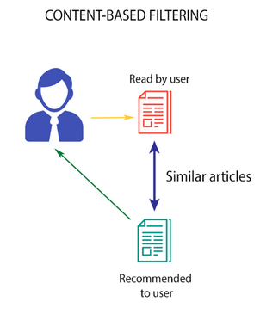
Types of Recommendation System ?​
A) Content-Based Recommendation Systems.
Content-based filtering methods are done based on user characteristics. This method is used in situations where data is known on an item such as name, location, or description and not on the user. It predicts the items based on user’s information and completely ignores contributions from other users as with the case of collaborative techniques. It uses the data that is provided by the user either explicitly or implicitly. When the user provides more content-based filtering mechanisms actions on the recommendations such as content-based recommender the engine becomes more and more accurate.

Slide 5
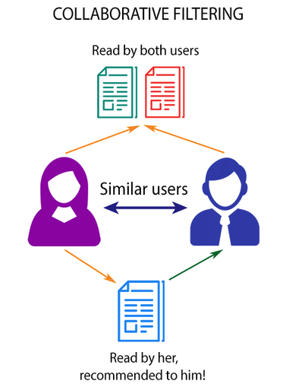
B) Collaborative Filtering Recommendation Systems.
This system identifies users with similar tastes and uses their opinion to recommend the same to another user with similar interest. It generates recommendations using information about rating profiles for different users or items. It has been implemented in different applications such as YouTube, Netflix, and Spotify. It is a widely used approach and is used as a part of the hybrid system.

Slide 6
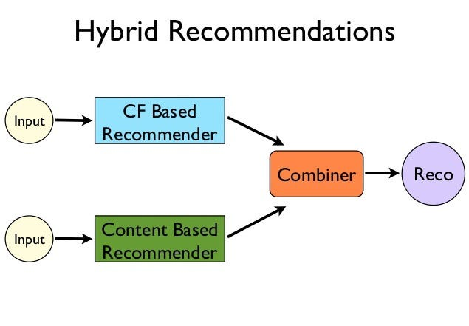
C) Hybrid Approach
A hybrid approach is a combination of collaborative filtering content-based filtering, or any other approaches. Hybrid approaches can be implemented by making predictions separately on content-based and collaborative-based approach and later combining them. It increases the accuracy and performance of the recommender systems.

Slide 7
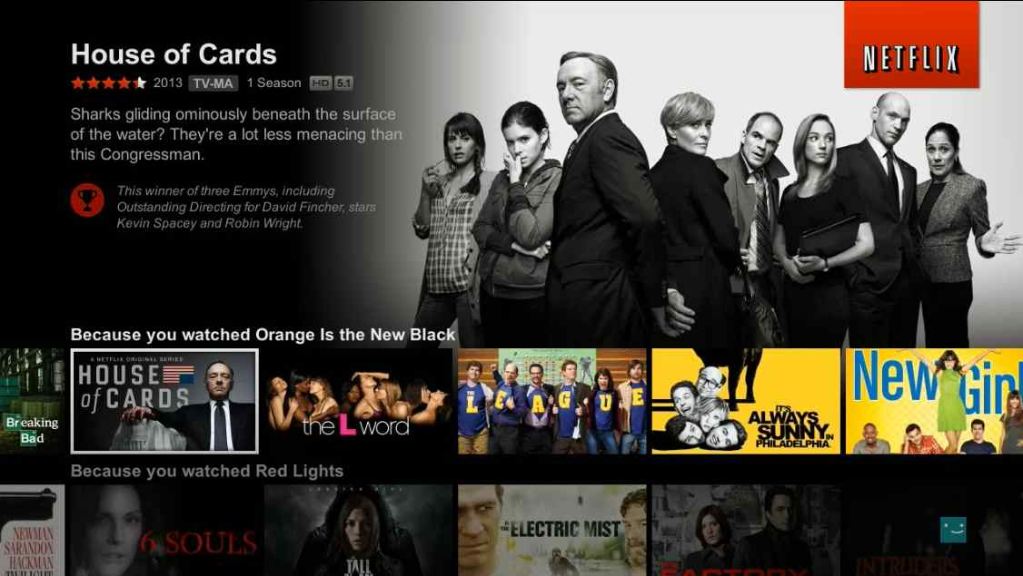
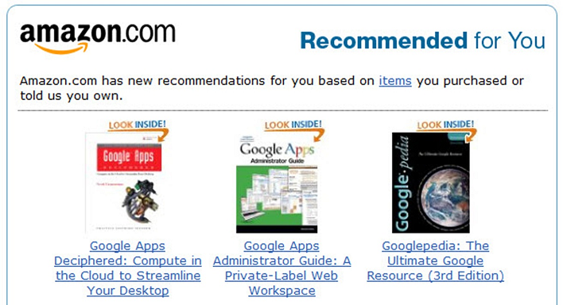
Examples...

Slide 8
Motivation
Personalization and User Experience:- Recommendation systems enable personalized content and product recommendations tailored to individual users' preferences, behaviors, and interests. This leads to improved user experiences, higher engagement, and increased user satisfaction.
Business Value:-Effective recommendation systems can lead to increased revenue by promoting relevant products or content to users.
Discovery of New Content:-Recommendation systems can introduce users to new and relevant content they might not have discovered on their own. This is particularly valuable in creative industries like music, literature, and art, where exposure to new works is essential.
Enhanced Engagement:-Platforms with strong recommendation systems tend to keep users engaged for longer periods. Engaged users are more likely to interact with advertisements, contribute user-generated content, and participate in community discussions.
Data Science and Machine Learning Applications:-Recommendation systems are a fascinating application of machine learning and data science techniques. Studying these systems provides insights into collaborative filtering, matrix factorization, deep learning, and more.
Social Impact:-In domains like healthcare, education, and public services, recommendation systems can be used to suggest personalized treatments, learning resources, or government services, thus contributing to improved outcomes and individual well-being.

Slide 9
Literature Survey​
S.N​ | Title of paper​ | Journal/Conference Name/Year of publication​ | Author Names​ | Summary of Paper​
1.​ | Movie Recommender System Using K-Means Clustering AND K-Nearest Neighbor | IEEE (2019) | Rishabh Ahuja, Arun Solanki, Anand Nayyar | The proposed work deals with the introduction of various concepts related to machine learning and recommendation system. In this work, various tools and techniques have been used to build recommender systems. Various algorithms such as K-Means Clustering, KNN, Collaborative Filtering, Content-Based Filtering have been described in detail.

Slide 10
2.​​ | FLEX: A Content Based Movie Recommender​ | 2020 International Conference for Emerging Technology (INCET) Belgaum, India. Jun 5-7, 2020 | Rujhan Singla1 , Saamarth Gupta2 , Anirudh Gupta3 , Dinesh Kumar Vishwakarma4 | FLEX extends existing approaches like Doc2Vec and tf-idf by using a hybrid of the two methods. We use publicly available features such as movie plots, ratings, countries of production and release year to find similarity between movies and generate a recommendation list.​
3. | Machine Learning Based Recommendation System | © 2014 IJEDR | ISSN: 2321-9939 | 1 Bhumika Bhatt, 2 Prof. Premal J Patel, 3 Prof. Hetal Gaudani | This paper classifies collaborative filtering in two types: Memory based and Model based Recommendation .The paper elaborates these approaches and their techniques with their limitations. This survey shows the road map for research in this area.
3.​​ | The Impact of Cloud Computing on Network Security and the Risk​​ for Organization Behaviors​​ | Webology, Volume 19, Number 1, January, 2022​​ | Alia J. Ouda, Hassan M. Ibrahim.​​ | The main vulnerability is​​ identifying through a review of the published works on the cloud computing environment with​​ possible solutions to overcome these threats and risks.​​

Slide 11
4. | A Collaborative Recommendation System for Online Courses ​​ | 2019 International Conference of Deep learning And Machine learning | Raghard Obeidat, Rehab Duwairi, Ahmad Al Aiad | we applied the SPADE algorithm on course sequences. The results are in harmony with the results obtained when Apriori was applied.
5. | Content Based Movie Recommendation System | International Journal of Research in Industrial Engineering 2020 | N. Pradeep * , K. K. Rao Mangalore, B. Rajpal, N. Prasad, R. Shastri | Based on a data set, it predicts what movies a user will like considering the attributes present in the previously liked movies. Recommendation systems can recommend movies based on one or a combination of two or more attributes. While designing a movie recommendation system various factors are considered such as the genre of the movie, the director or the actors present in it. In this paper, the recommendation system has been built on cast, keywords, crew, and genres.

Slide 12
Summary/findings of Literature Survey
Dominance of Collaborative Filtering and Content-Based Methods:
Hybrid Approaches:
Deep Learning's Impact:
Contextual and Temporal Information:
Context-Aware Recommendations:
Personalization Dominates:
Diverse Recommendation Strategies:
Real-World Applications:
Data Privacy and Security:
Machine Learning Algorithms:

Slide 13
Objectives​
Personalization: The primary objective of most recommendation systems is to provide personalized recommendations to users based on their preferences, behaviors, and past interactions. The system aims to understand individual users' tastes and interests to suggest content or items that are likely to be of interest to them.
User Engagement: Recommendation systems aim to increase user engagement by suggesting content that captures users' attention and keeps them interacting with the platform for longer periods. Engaged users are more likely to continue using the service and generating valuable data for the recommendation algorithms.
Improved User Experience: By offering relevant and interesting recommendations, recommendation systems enhance the overall user experience. Users appreciate platforms that understand their needs and help them discover content that aligns with their interests.
Discovery of New Content: While personalization is important, recommendation systems also seek to introduce users to new and diverse content they might not have encountered otherwise. This encourages exploration and helps users discover hidden gems or items outside their usual preferences.
Increased Sales and Revenue: In e-commerce platforms, one of the main objectives is to boost sales by suggesting products that users are likely to purchase. Effective recommendations can lead to higher conversion rates and increased revenue for the platform.

Slide 14
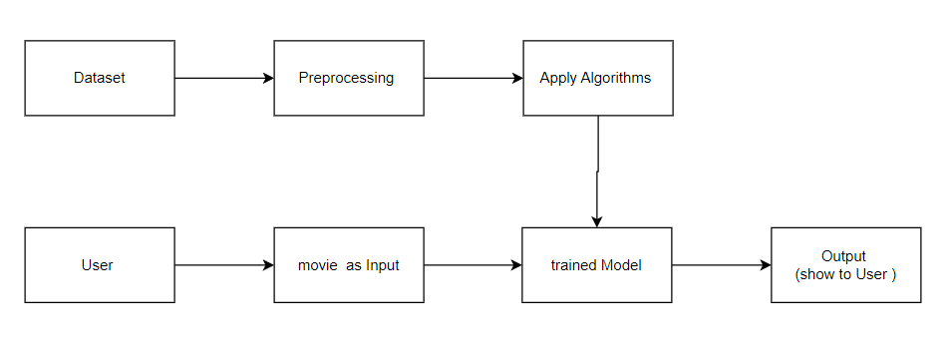
System Architecture Diagram

Slide 15
References
Content Based Movie Recommendation System ,International Journal of Research in Industrial Engineering 2020, by N. Pradeep * , K. K. Rao Mangalore, B. Rajpal, N. Prasad, R. Shastri.
Movie Recommender System Using K-Means Clustering AND K-Nearest Neighbor, IEEE (2019) by authors Rishabh Ahuja, Arun Solanki, Anand Nayyar.
FLEX: A Content Based Movie Recommender ,2020 International Conference for Emerging Technology (INCET) Belgaum, India. Jun 5-7, 2020 by Rujhan Singla1 , Saamarth Gupta2 , Anirudh Gupta3 , Dinesh Kumar Vishwakarma.
Machine Learning Based Recommendation System , International Journal of Engineering Development and Research (www.ijedr.org) 2014 by 1 Bhumika Bhatt, 2 Prof. Premal J Patel, 3 Prof. Hetal Gaudani .
A Collaborative Recommendation System for Online Courses 2019 International Conference of Deep learning And Machine learning by Raghard Obeidat, Rehab Duwairi , Ahmad Al Aiad.

Slide 16
Technology Stack
Stages
Dataset Collection
Data Preprocessing
Models Analysing
Model Building
Intergration into Website
Deployment (on Internet )
Python
Streamlit
Jupyter Notebook
Python Libraries
Streamlit Cloud For
Deployment
Git/Github

Slide 17
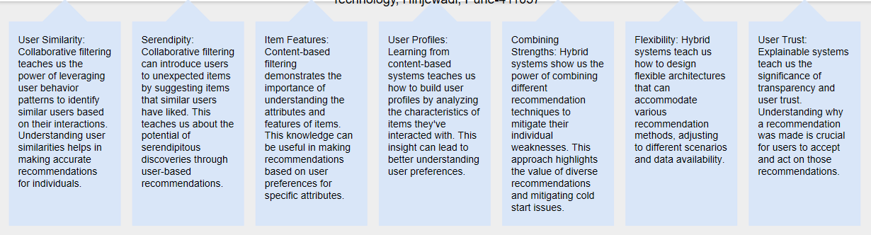
Conclusion

Slide 18

Implemetation
https://aranavmahalpure-movie-recommendation-system--app-bofu8x.streamlit.app/

Slide 19


Slide 20
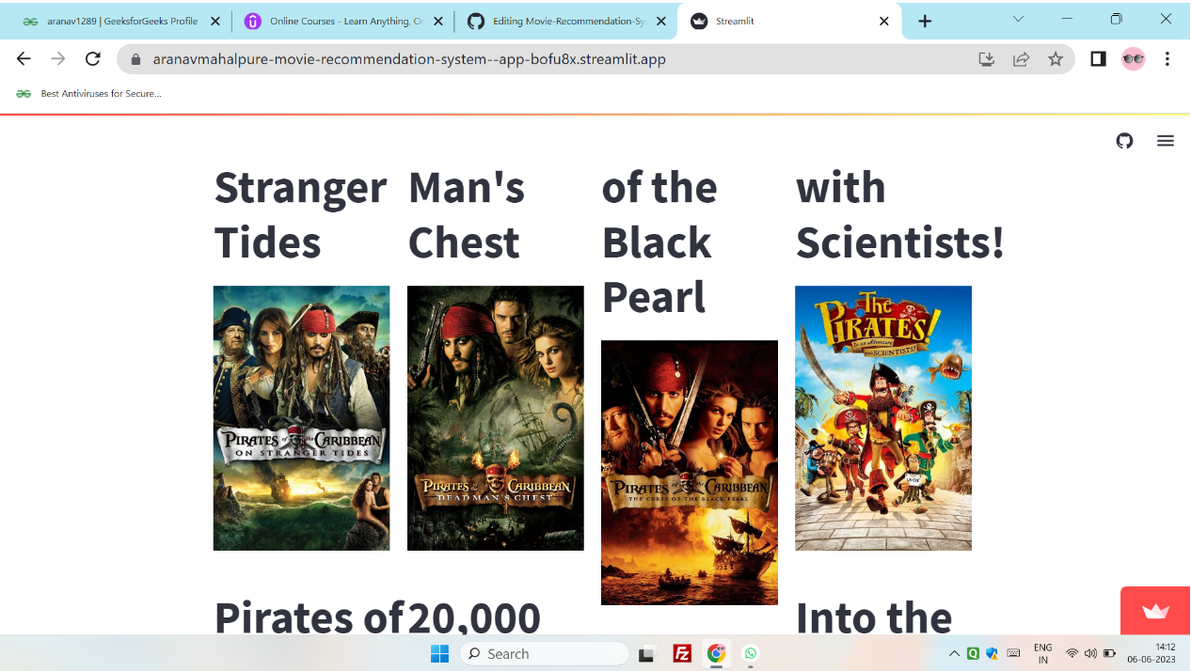

Slide 21


